Slide 1
Adobe Framework & AWS Cost

Slide 2
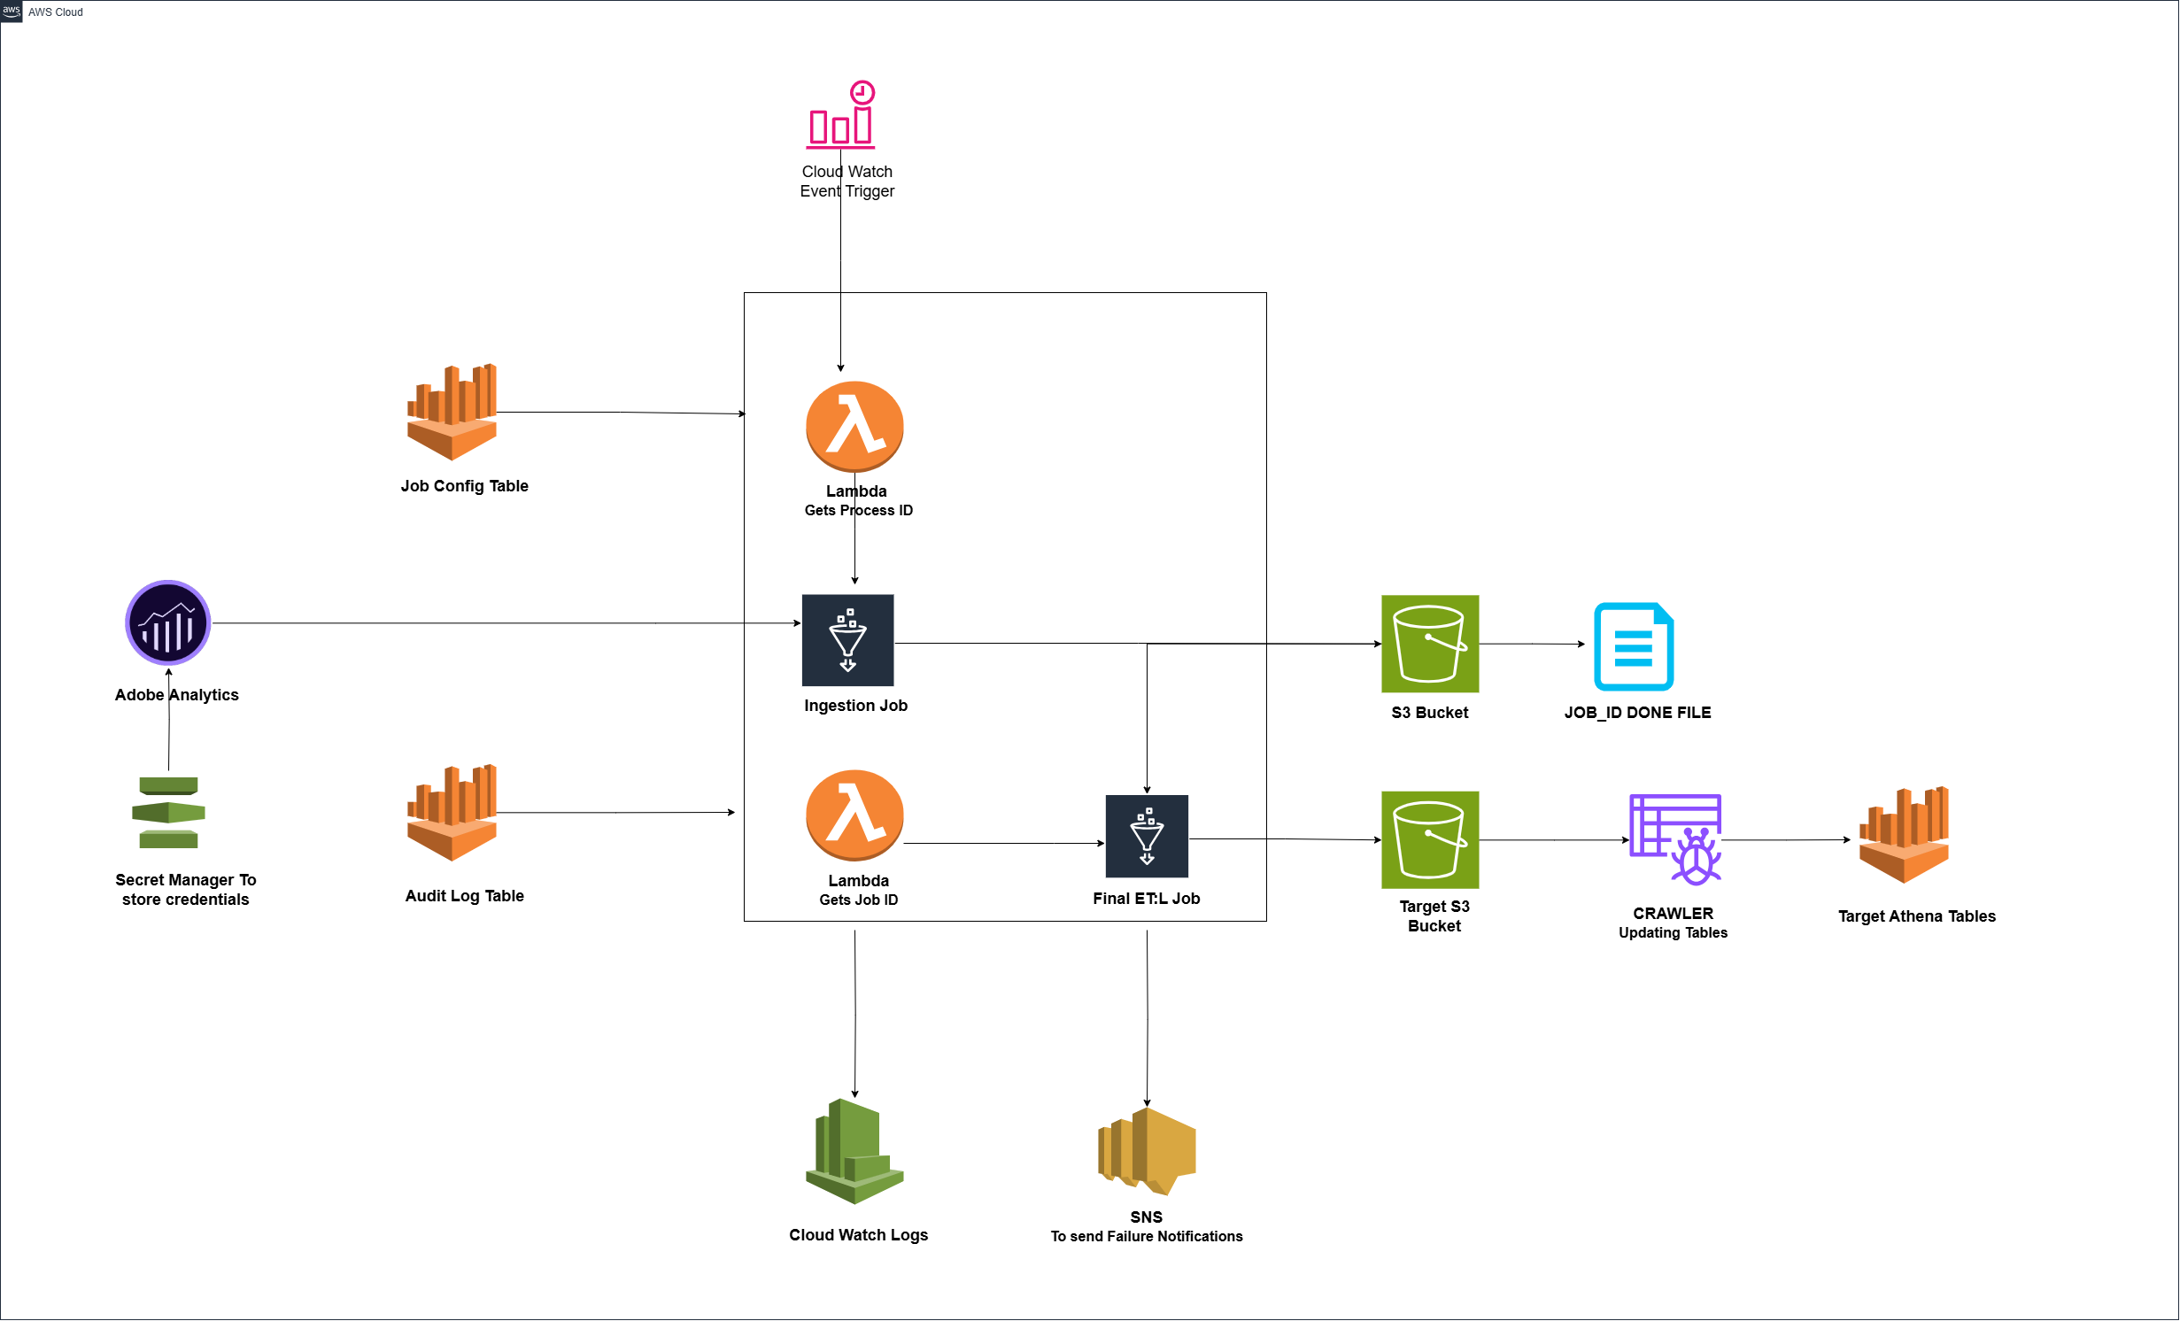
Adobe Old Framework
CloudWatch triggers the Lambda based on the scheduled time
Lambda gets Process IDs from Config table & Triggers the Glue job
Glue job hits the Adobe through API calls & load JOBID_DATE.Done File into s3
Glue job adding entries as In progress, Succeed, Failed in audit log table & config table
The Glue job fetches data from the source S3 path based on the queries executed in Athena
Another Lambda gets the Job_ID from config table & triggers the next glue job
The 2nd Glue job will do the transformations and write into target tables
API endpoints & credentials are store in secret manager.
Failed jobs will send email to respective team through SNS
CloudWatch stores logs for both the Glue jobs and the lambda functions.
1
2
3
4
5
6
7
8
9

Slide 3
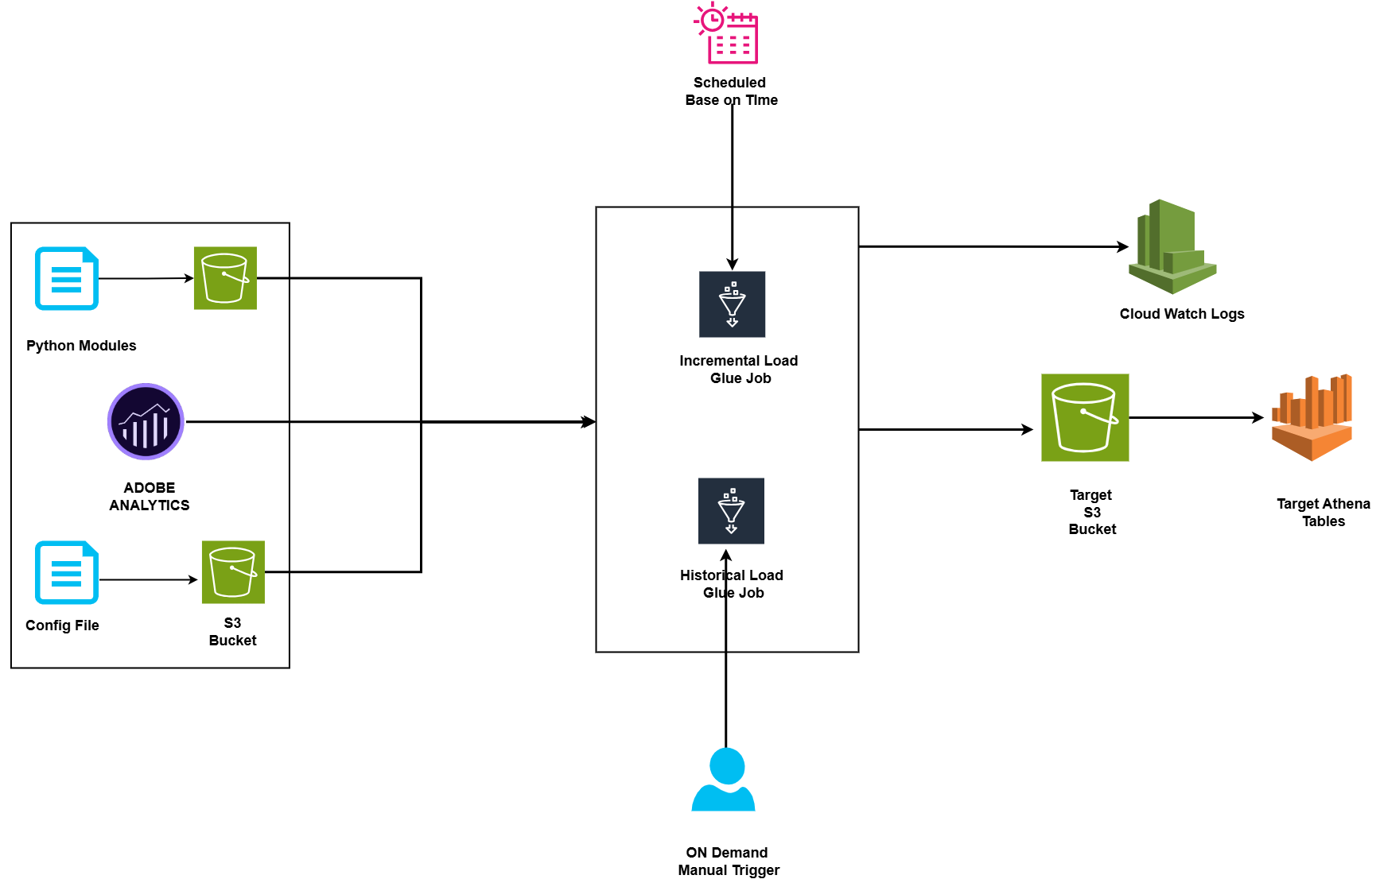
Adobe New Framework
Historical job is designed & run based on On demand trigger
Incremental job is designed & run based on scheduled time
Both the jobs has a config file, it has written some lists of items to pass while calling Adobe API.
Python module used to make Adobe API connection, get date & write data to s3
Both the Glue jobs calling the API by passing the parameters used in config file
Retrieving the Adobe data by applying various transformations .
Transformed data is written to target s3 path & created Hive table directly in athena.
Cloud Watch stores logs for both the Glue jobs and the lambda functions.
1
2
3
4
5
6
7
8

Slide 4
Observations in Both Framework
Existing Adobe Framework has Config tables, Audit tables to read Process IDs & adding entries of job status
Existing Adobe Framework run completely based on scheduled time given in cloud watch
Existing Adobe Framework has used 2 lambda functions & 2 glue jobs to read the adobe API in one job, transform and process it in another job
Crawlers has been used in Existing Adobe framework to create tables.
SNS has been used to send the failure notifications to respective team in Existing Adobe Framework
Secret Managers has been used to store the API endpoints & credentials in Existing Adobe Framework
Two jobs has been created Historical load & Incremental Load in New Adobe Framework
Historical load job run based on ON-Demand Trigger, Incremental Load job run based on Scheduled basis
Config file has been used to store & pass the parameters while calling Adobe API
Historical load & Incremental load date information has been added in the config file
Without using crawler, the Athena table has been created by using query in the job itself
1
2
3
4
5
6
7
8
9
10
11

Slide 5
AWS Cost Summary – EDS Account
Date | Month | Billing Summary | Cost Explorer (All) | Cost Explorer (Glue)
19-03-2025 | OCT-24 | $49,429.06 | $64,910.00 | $28.392.01
19-03-202 | NOV-24 | $67,528,80 | $88,690.91 | $47,816.57
19-03-2025 | DEC-24 | $72227.29 | $94,615.47 | $53,600.23
19-03-2025 | JAN-25 | $76,413.39 | $100,023.72 | $49,994.37
19-03-2025 | FEB-25 | $62,028.49 | $81,277.63 | $41,527.14
19-03-2025 | MAR-25 | $36.241.96 | $79,817.05 | $32,662.40
20-03-2025 12PM | MAR-25 | $37,603.07 | $49,387.23 | $20706.98
20-03-2025 9PM | MAR-25 | $38,292.58 | $49,387.23 | $38,292.5
21-03-2025 12PM | MAR-25 | $37,603.07 | $49,387.23 | $21,013.10
21-03-2025 9PM | MAR-25 | $39,885.16 | $51,882.35 | $21,557.38
24-03-2025 12PM | MAR-25 | $43,552.05 | $57,226.43 | $23,352.56
24-03-2025 9PM | MAR-25 | $43,552.05 | $57,226.43 | : $23,352.56
25-03-2025 12PM | MAR-25 | $44566.26 | $58553.26 | $23,794.36

Slide 6
Thank you message
© 2024 eClerx. All rights reserved. This presentation and its contents are protected by copyright laws and international treaties. Unauthorized use, reproduction, duplication, or distribution of this material, in whole or in part, is strictly prohibited. No portion of this presentation may be copied, transmitted, or otherwise used, in any form or by any means—whether electronic, mechanical, or otherwise—without the express prior written consent of eClerx. Any unauthorized use or distribution of this material may result in legal action.

